Slide 1
Prediction and Analysis of Heart Disease Using Machine Learning
By Ananya Rai S

Slide 2
Introduction
Heart disease is one of the leading causes of death worldwide.
Early detection can help reduce risks and save lives.
With the availability of medical data, machine learning models can be used to predict heart disease accurately.
This project analyzes patient health parameters such as age, blood pressure, cholesterol, and heart rate.
The goal is to predict whether a person has heart disease or not, helping doctors in better decision-making.

Slide 3
Objective & Problem Statement
Objective
To develop a system that can predict heart disease using patient health data.
This helps in identifying high-risk patients at an early stage.
Early prediction supports better medical decision-making.
Problem Statement
Heart disease is one of the leading causes of death worldwide.
Traditional diagnosis methods can be time-consuming and may miss early signs.
Predict whether a person has heart disease based on medical attributes using Python.

Slide 4
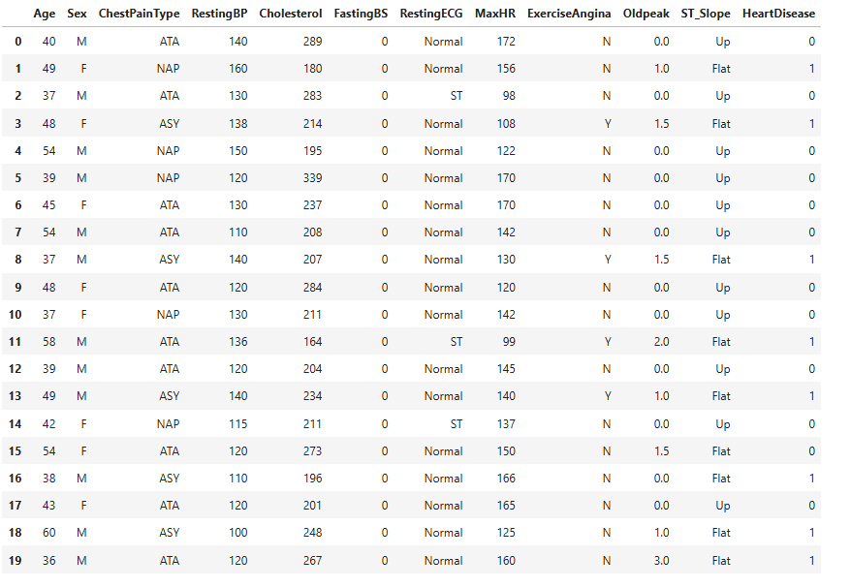
Dataset Overview
Age: Age of the patient .
Sex: Gender of the patient (M = Male, F = Female).
Chest Pain Type: Type of chest pain experienced (ATA, NAP, ASY, TA).
ATA- unusual heart-related pain, TA-heart-related pain due to low blood flow, NAP-not related to the heart, ASY-no chest pain symptoms.
Resting BP: Resting blood pressure measured in mm Hg.
Cholesterol: Serum cholesterol level in mg/dL.
Fasting BS: Fasting blood sugar (1 if >120 mg/dL, else 0).
Resting ECG: Resting electrocardiogram results (Normal, ST, LVH).
MaxHR: Maximum heart rate achieved during exercise.
Exercise Angina: Exercise-induced angina (Y = Yes, N = No).
Old peak: ST depression induced by exercise relative to rest.
ST_Slope: Slope of the peak exercise ST segment (Up, Flat, Down).

Slide 5
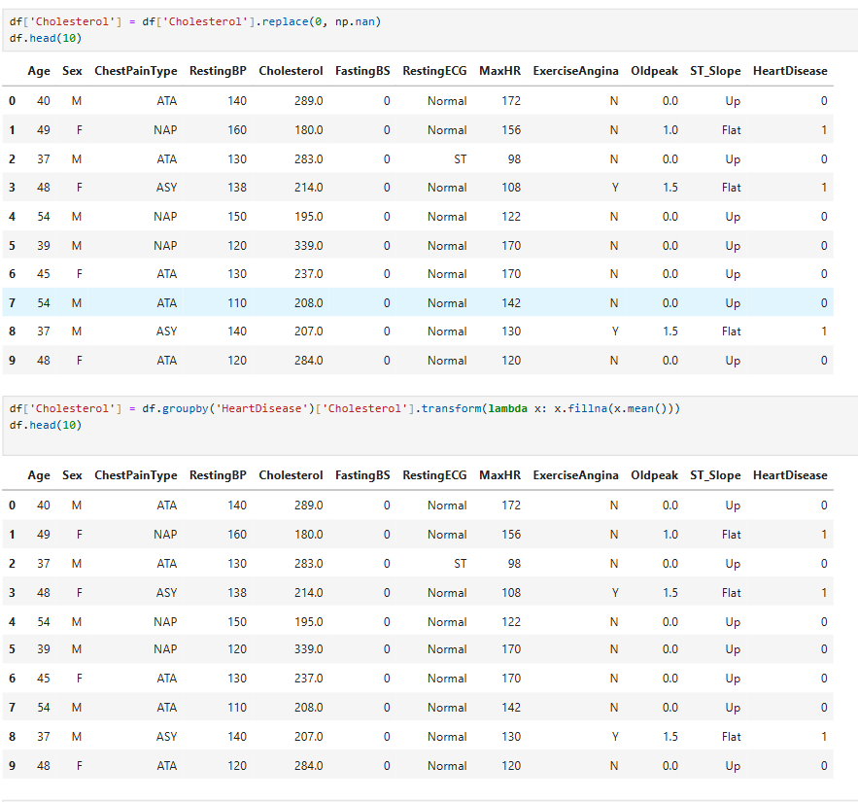
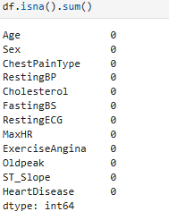
DATA CLEANING
Data cleaning is the process of fixing or removing incorrect, missing, or duplicate data from a dataset.
All 0 values in the Cholesterol column are replaced with NaN because 0 is not a valid cholesterol value.
Then, missing (NaN) cholesterol values are filled with the average cholesterol of their Heart Disease group (0 or 1)

Slide 6
visualization
Visualization means showing data in the form of pictures or graphs so that it becomes easy to understand patterns, trends, and comparisons.
Common types of visualizations:
Bar chart – compare categories
Line graph – show change over time
Scatter plot – show relationship between two values
Histogram – show data distribution
Heat map – show intensity or correlation
Pie chart – show proportions or percentage
Count Plot - Shows the frequency (count) of each category in a categorical variable.

Slide 7
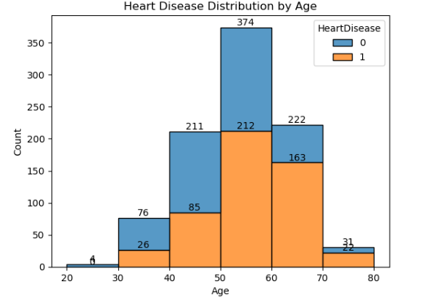
Heart Disease Distribution by Age
This histogram shows how heart disease cases (1) and non–heart disease cases (0) are distributed across age groups.
1.Very few people aged 20–30Almost no cases of heart disease.
2.Age 30–40: Risk begins to appear.
People without heart disease are more than those with heart disease.
Heart disease cases start to increase, but moderately.
3. Age 40–50: Sharp increase.
Heart disease count becomes significant.
This is the starting age where heart disease becomes common.
4. Age 50–60: Highest counts
Maximum number of heart disease cases occur here.
Both heart disease and healthy groups are around 200+
Age 50–60 is the most critical range.
5. Age 60–70: High risk
Total people are slightly fewer than 50–60.
Proportionally, more people have heart disease than those without in this age range.
6. Age 70–80: Decline in counts
Fewer total individuals.
Heart disease still present in good proportion
This shows older people remain high-risk even though sample size
Insights
Heart disease is strongly age-dependent.(The older a person gets, the higher the probability of heart disease.)
Risk rises sharply after age 30 The frequency of heart disease cases jumps from 40–50 onwards.
Peak risk is at 50–60 The highest number of heart disease cases and high total patients.
High proportion of heart disease after age 60 Even with fewer total people, more of them are heart patients.

Slide 8
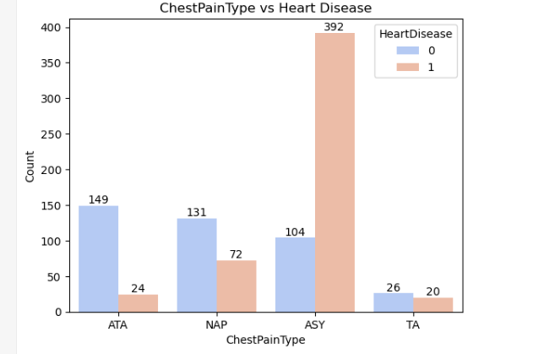
Heart Disease by Chest Pain Type
This is a count plot showing how different chest pain types (ATA, NAP, ASY, TA)relate to the presence of heart disease
1.ATA(Atypical Angina- unusual heart-related pain) and NAP(Non-Anginal Pain- not related to the heart) categories mostly have no heart disease
ATA: 149 healthy vs 24 heart disease
NAP: 131 healthy vs 72 heart disease
Even though some heart disease cases exist, most people in ATA/NAP are healthy.
2. ASY (Asymptomatic-no chest pain symptoms) has the highest heart disease cases.
People with ASY chest pain have extremely high heart disease counts (392).
This is the strongest indicator of heart disease.
3. TA (Typical Angina - heart-related pain due to low blood flow) has fewer people overall But distribution is almost equal between healthy and heart disease.
Insights
ASY chest pain type is the strongest predictor of heart disease.(People who do not show chest pain symptoms (ASY) are the most likely to have heart disease.)
ATA chest pain is mostly found in healthy people. This pattern shows ATA is generally not a dangerous sign.
NAP has a moderate risk Higher counts in healthy people but also a considerable number with heart disease.
TA is low-frequency but balanced This doesn’t show a strong differentiation.

Slide 9
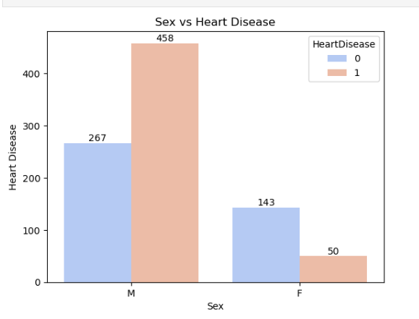
Heart Disease by Sex
This is a count plot comparing Sex (M/F) with the presence of Heart Disease.
Heart disease is much more common in males than females.
Males show a much higher risk of heart disease.
Females show a lower prevalence of heart disease.
Reasons why men show more heart disease:
Blood pressure
Cholesterol
Smoking rates and Alcohol consumption.
Stress and lifestyle‐related risks
Solutions:
Lifestyle Improvements
Regular exercise (30–45 min/day)
Reduce salt, sugar, and oily food
Increase fruits, vegetables, whole grains
2. Control Risk Factors
Monitor BP, Cholesterol, Blood Sugar especially after age 35
Early medication if needed
Stop smoking & Reduce alcohol
3. Stress Management
Meditation
Yoga
Better sleep.
Avoid long-term untreated stress

Slide 10
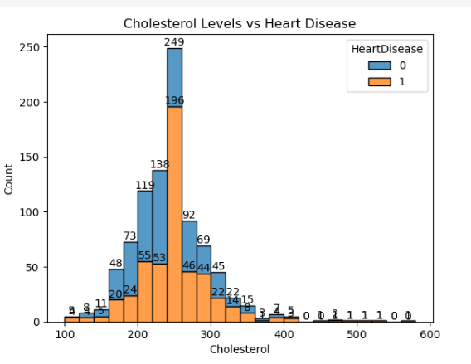
Cholesterol Distribution
The histogram cholesterol distribution.
People with borderline and high cholesterol (200–260 mg/dL) show a higher rate of heart disease.
Very low cholesterol fewer heart disease cases.
Cholesterol alone does not determine heart disease, but it contributes significantly.

Slide 11
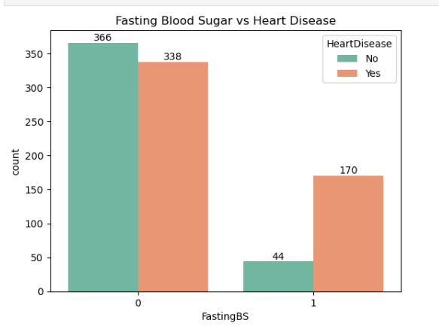
Fasting Blood Sugar
1.The Fasting Blood Sugar = 0 (Normal <100mg/dl).
Even with normal fasting sugar, many people still have heart disease.
Normal sugar does not guarantee a healthy heart.
2. The Fasting Blood Sugar = 1 (High >120)
High fasting blood sugar strongly increases heart disease risk.
People with diabetes (or prediabetes) are at higher risk.

Slide 12
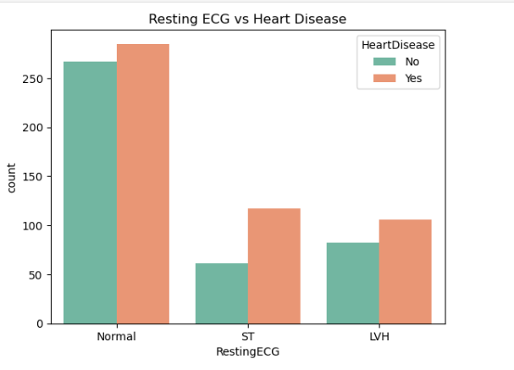
Resting ECG Results
Normal ECG(Heart rhythm looks normal):Many people are healthy, but some still have heart disease.
ST abnormality(ECG shows stress or damage in the heart): More people have heart disease than normal cases
LVH(Left Ventricular Hypertrophy-Hearts left chamber is thickened): Also shows higher heart disease cases than healthy ones.
People with abnormal ECG results (ST or LVH) are more likely to have heart disease, while normal ECG is seen more in people without heart disease.

Slide 13
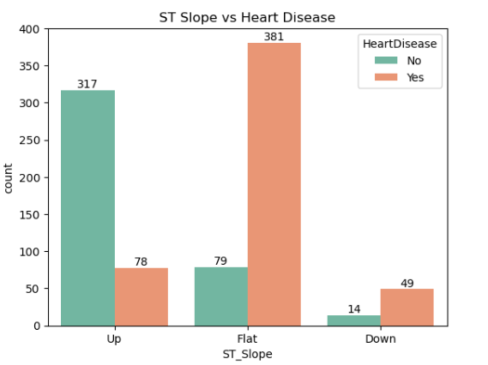
ST Slope vs Heart Disease
This count plot illustrates the relationship between the ST segment slope observed on an electrocardiogram (ECG) and the presence of heart disease
Interpretation:
Up slope:
Most people do not have heart disease
Indicates a healthier heart condition
Flat slope:
Highest number of heart disease cases
Strongly associated with heart disease
Down slope:
Fewer people overall, but more cases with heart disease than without
Indicates higher risk

Slide 14
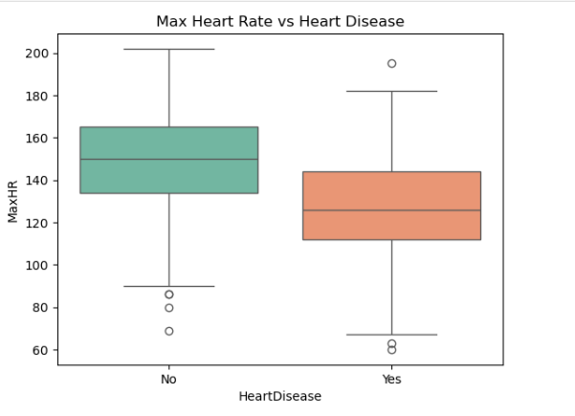
Maximum Heart Rate (MaxHR)
1.People without heart disease (No):
Median MaxHR = 150
Values mostly between 135 – 165
Some people reach 200+ bpm
People without heart disease generally have a higher maximum heart rates.
2. People with heart disease (Yes):
Median MaxHR ≈ 125
Most values between 110 – 145
Some very low values: 60–70 bpm
People with heart disease have significantly lower MaxHR.

Slide 15
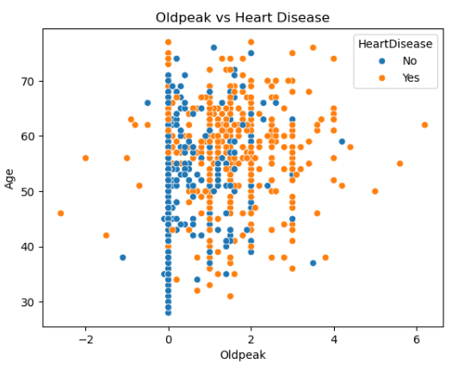
Old peak vs Heart Disease
Old peak measures how much the heart is stressed during exercise
Patients with low Old peak values (near 0) mostly do not have heart disease.
As Old peak increases, more orange dots appear, meaning a higher chance of heart disease.
Older patients with higher Old peak show a greater risk.
As Old peak increases, the chance of heart disease increases

Slide 16
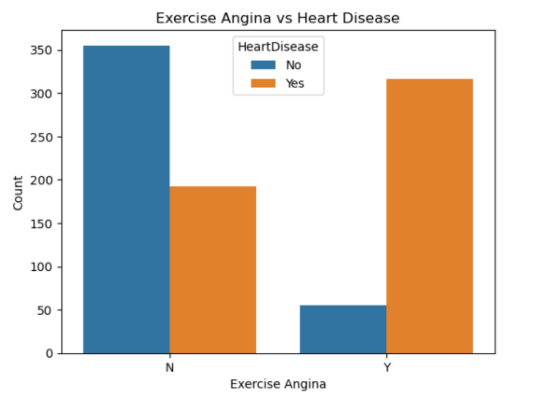
Exercise Angina vs Heart Disease
This bar count plot shows the relationship between Exercise Angina and Heart Disease.
The graph compares exercise angina (chest pain during exercise) with heart disease.
Exercise Angina = N (No angina during exercise):
Most patients do not have heart disease.
Fewer patients have heart disease.
Exercise Angina = Y (Angina during exercise):
Most patients have heart disease.
Very few patients do not have heart disease
Patients who experience angina during exercise are much more likely to have heart disease compared to those who do not experience angina.

Slide 17
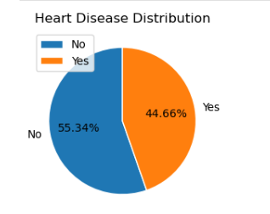
Heart Disease Distribution
The dataset represents a population that is high-risk.
This explains why earlier plots (sex, cholesterol, age) show strong patterns.
To Prevent Heart Disease
Lifestyle Improvements
Regular exercise (30–45 min/day)
Reduce salt, sugar, and oily food
Increase fruits, vegetables, whole grains
2. Control Risk Factors
Monitor BP, Cholesterol, Blood Sugar especially after age 35
Early medication if needed
Stop smoking & Reduce alcohol
3. Stress Management
Meditation, Yoga
Better sleep
Avoid long-term untreated stress

Slide 18
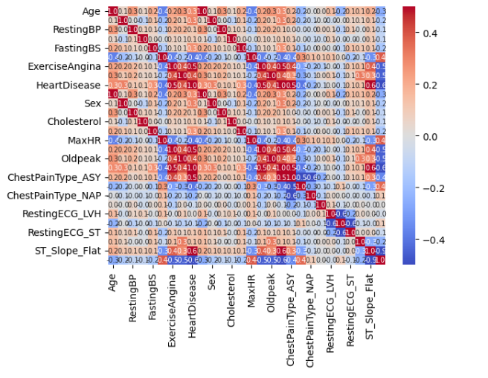
Heat Map
A heat map is a color-based chart that shows the strength of relationships between variables.
This heat map shows correlation between different health features and Heart Disease.
Red color indicates a strong positive relationships( one increases, the other increases).
Blue color means a negative relationship (as one increases, the other decreases).
Light/white color means weak or no relationship.
Overall, the visualization shows how different health factors like age, cholesterol, blood pressure, and exercise-induced angina are related to heart disease. By using graphs and charts, we can easily compare patients with and without heart disease.

Slide 19
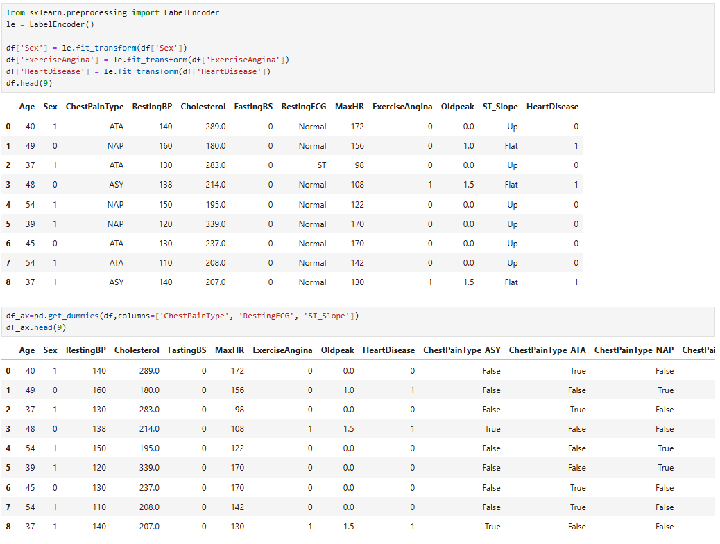
ENCODING
Encoding is the process of converting categorical (text) data into numerical values. Machine learning models cannot understand text, so encoding is required. Encoding is an important data preprocessing step before model training.
Label Encoding is used to convert binary categorical columns like Sex, Exercise Angina, and Heart Disease into numeric values (0 and 1) so models can understand them.
One-Hot Encoding (get_dummies) is applied to multi-category columns (ChestPain Type, Resting ECG, ST_Slope), creating separate boolean columns for each category.

Slide 20
Machine Learning
Machine Learning is a branch of Artificial Intelligence (AI) that allows computers to learn from data and make predictions or decisions without being explicitly programmed.
Feature Selection
Feature selection is the process of choosing the most important input variables from a dataset. It helps improve model accuracy, reduce overfitting, and make the model faster and easier to understand.
Independent variables (X):
Age, Sex, RestingBP, Cholesterol, FastingBS, MaxHR, ExerciseAngina, Oldpeak, ChestPainType (ASY, ATA, NAP, TA), RestingECG (LV, Normal, ST), and ST_Slope (Down, Flat, Up).
Dependent variable (Y):
Heart Disease – indicates whether a patient has heart disease (Yes/No).

Slide 21
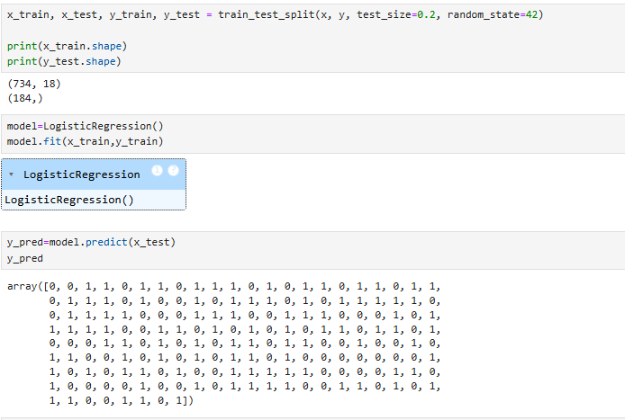
Logistic Regression
Logistic Regression is a machine learning algorithm used for classification, mainly Yes/No (0/1) problems.
Split the Dataset :
The data is divided into training (80%) and testing (20%) sets.
Training data is used to teach the model, testing data is used to check accuracy.
Check Data Shape:
x_train (734, 18) → 734 records with 18 features for training.
y_test (184,) → 184 target values for testing.
Create Logistic Regression Model:
Logistic Regression is used for binary classification (Yes/No, 0/1).
Make Predictions:
The trained model predicts outcomes for x_test
Output (y_pred) contains 0 and 1.

Slide 22
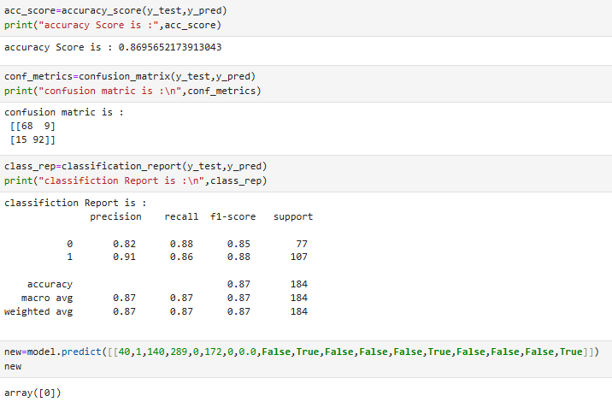
Model Evaluation
Accuracy Score:
Accuracy = 0.87
Accuracy shows how many predictions the model got correct overall
Confusion Matrix:
Confusion matrix compares actual vs predicted values.
68 → Correctly predicted No disease (0)
92 → Correctly predicted Disease (1)
9 → Wrong prediction (False Positive)
15 → Wrong prediction (False Negative)
Classification Report:
Class | Precision | Recall | F1-Score | Support
0 (No Disease) | 0.82 | 0.88 | 0.85 | 77
1 (Disease) | 0.91 | 0.86 | 0.88 | 107
Precision:
Out of all predicted positives, how many are actually correct.
Precision=TP/(TP+FP)
Recall:
Out of all actual positives, how many the model correctly found.
Recall=TP/(TP+FN)
F1-score:
Balance between precision and recall.
Support
Number of actual samples for each class.

Slide 23
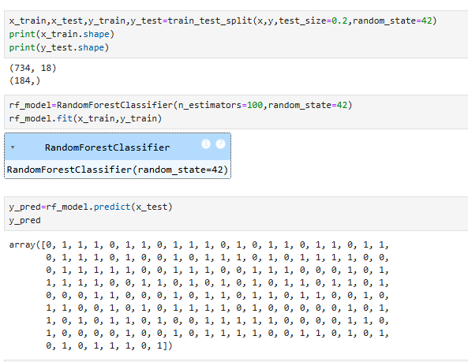
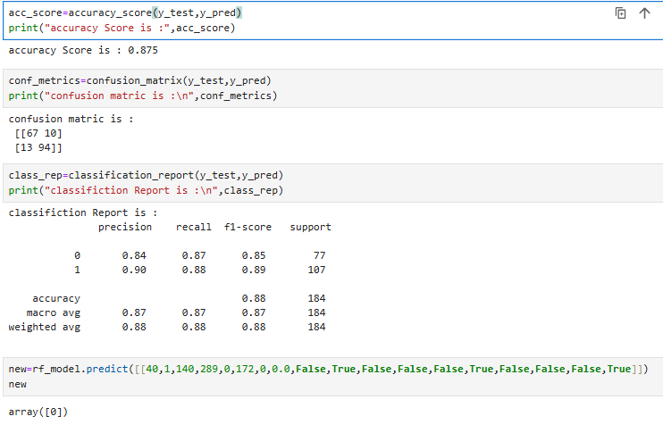
Random Forest Classifier
Random Forest Classifier is a machine learning algorithm that makes predictions by combining the results of many decision trees.
Accuracy = 0.87
Confusion Matrix:
67 → Correctly predicted No disease (0)
94 → Correctly predicted Disease (1)
10 → Wrong prediction (False Positive)
13 → Wrong prediction (False Negative)
Classification Report:
Class | Precision | Recall | F1-Score | Support
0 (No Disease) | 0.84 | 0.87 | 0.85 | 77
1 (Disease) | 0.90 | 0.88 | 0.89 | 107

Slide 24
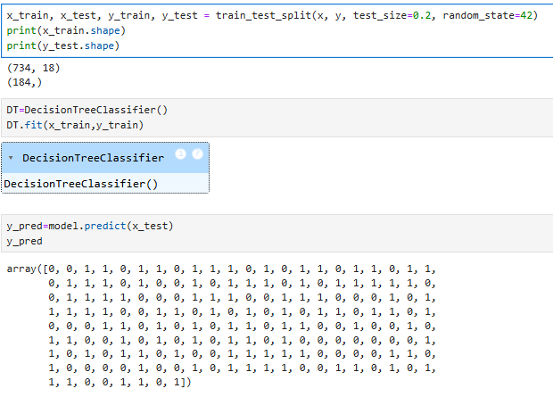
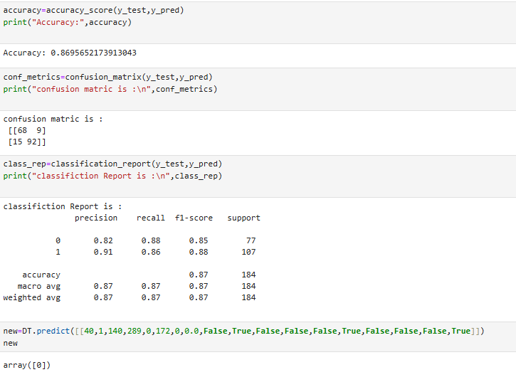
Decision Tree Classifier
A Decision Tree is a machine learning algorithm that makes decisions by asking yes/no questions.
Accuracy = 0.87
Confusion Matrix:
68 → Correctly predicted No disease (0)
92 → Correctly predicted Disease (1)
9 → Wrong prediction (False Positive)
15 → Wrong prediction (False Negative)
Classification Report:
Class | Precision | Recall | F1-Score | Support
0 (No Disease) | 0.82 | 0.88 | 0.85 | 77
1 (Disease) | 0.91 | 0.86 | 0.88 | 107

Slide 25
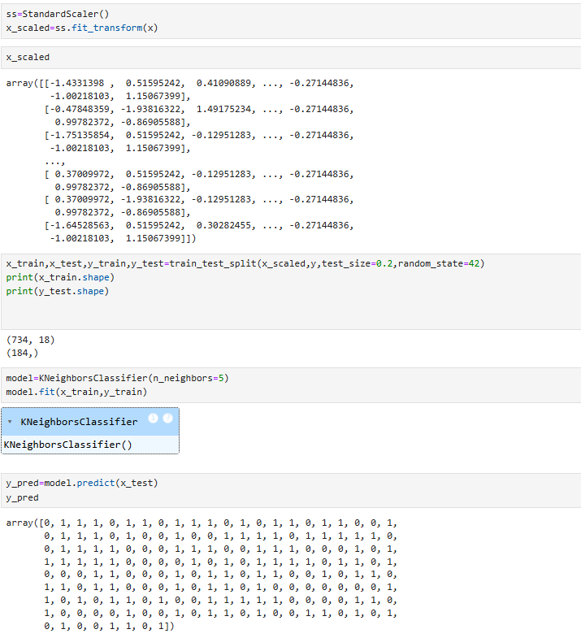
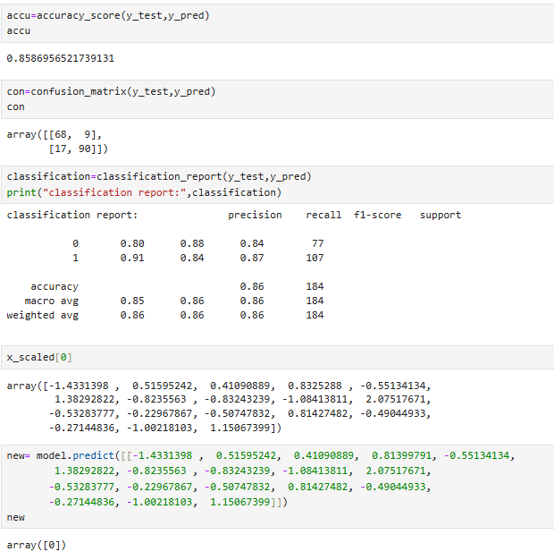
K-Nearest Neighbors (KNN) Classifier
KNN is a machine learning algorithm that classifies a data point based on the nearest data points around it.
Accuracy = 0.85
Confusion Matrix:
68 → Correctly predicted No disease (0)
90 → Correctly predicted Disease (1)
9 → Wrong prediction (False Positive)
17→ Wrong prediction (False Negative)
Classification Report:
Class | Precision | Recall | F1-Score | Support
0 (No Disease) | 0.80 | 0.88 | 0.84 | 77
1 (Disease) | 0.91 | 0.84 | 0.87 | 107

Slide 26
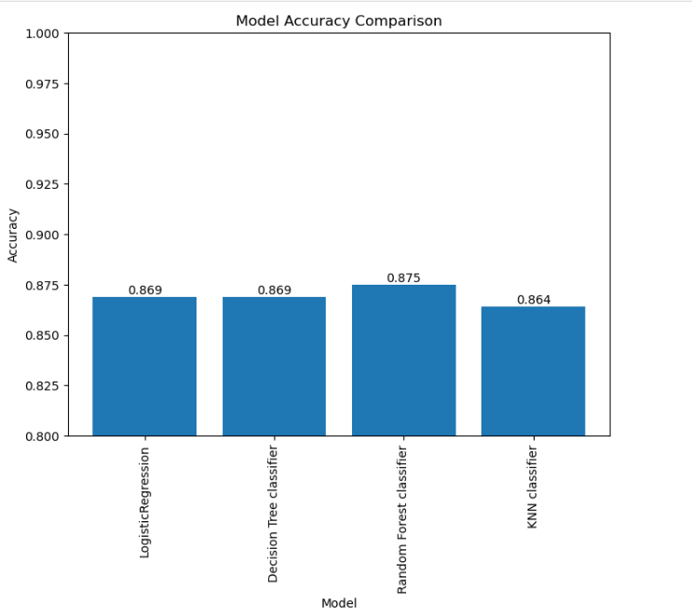
Comparison of Machine Learning Model Accuracies
This bar chart compares the accuracy of different machine learning models.
Random Forest Classifier gives the highest accuracy (87.5%), so it performs the best
Logistic Regression and Decision Tree have similar accuracy (86.9%).
KNN Classifier has slightly lower accuracy (86.4%).
Conclusion:
Among the tested models, the Random Forest Classifier performed the best with an accuracy of 87.5%. This shows that machine learning can reliably predict heart disease, helping in early detection and better healthcare decisions.

Slide 27
Conclusion
This project demonstrated how machine learning can effectively predict heart disease using patient health data.
Risk Factors: Age, sex, chest pain type (especially asymptomatic cases), cholesterol, and blood sugar are strong indicators of heart disease risk. Men and individuals aged 50–60 are at highest risk.
Data Processing: Proper handling of missing values and encoding categorical data allowed models to learn patterns accurately.
Model Performance: Among Logistic Regression, Decision Tree, K-Nearest Neighbors, and Random Forest, the Random Forest Classifier achieved the highest accuracy (87.5%), showing reliable prediction capability.
Healthcare Impact: Early prediction using these models can help doctors identify high-risk patients sooner, enabling timely interventions, lifestyle guidance, and treatment to prevent severe outcomes.

Slide 28
THANK YOU

